Slide 1
Comité programme Le Maillon Grand-Sault, 1999. ©

Slide 2
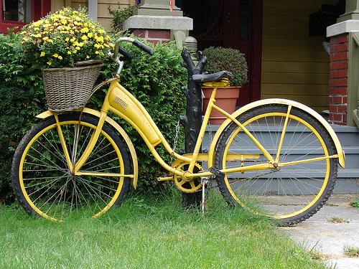
Overview
What is a link?
Where are links found?
What is The Link Program?
What are companions?
What is their role?
How can they be identified?
For what issues can they be contacted?
Contact
Continuity of service…
Conclusion
Questions?

Slide 3
What is a link?
It’s a ring in a chain.

Slide 4
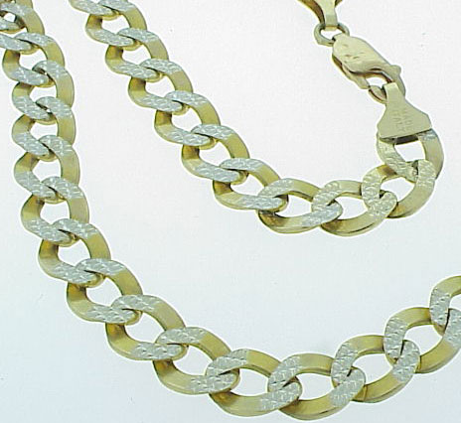
Où retrouve-t-on des maillons?
Where are links found?

Slide 5
What is The Link Program?
You’re experiencing a difficult situation? The Link Program is there for you. With the support of a LINK COMPANION or of a trusted person, you will have an opportunity to talk about your concerns and, if needed, to access support services in the community using the HELPING TREE. By facilitating access to support services, we want to give you the opportunity to solve your issues before they escalate and lead to more serious situations. The program is available in grade 6th to 12th schools.

Slide 6
Qu’est-ce que le programme
What is a LINK companion?
Someone you can talk to about your issues.
Someone who can help you find ways to solve your issues.
Someone you can count on.

Slide 7
What is their role?
To listen to you and help you find the help you need to solve your issue!

Slide 8
How can they be identified?

Slide 9
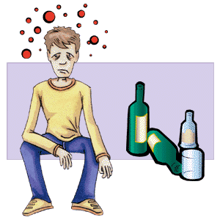
For what issues can they be contacted?
All issues !!!
Bullying
Unexpected pregnancy
Stress
Drugs and alcohol

Slide 10
Contact them
Directly
By using your card

Slide 11
Continuity of service…
Because we care…

Slide 12
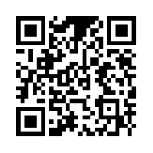
Accessing the LINK helping trees
www.thelinkprogram.com

Slide 13
Conclusion
The LINK program is there for you!
www.thelinkprogram.com

Slide 14
« Questions »

